Slide 1

PLATFORM ENGINEERING · VMWARE
Building Servers from Vault Secrets
with Terraform and Chef
A hands-on guide for platform engineers on VMware,
ending with a reference build for an Ansible control node.

Slide 2
PIPELINE DESIGN
Secrets come first, so the pipeline is built around Vault
Establish policy and authentication before creating machines. Each stage receives only the access it needs; the server retrieves its own runtime secrets.
01
02
03
04
Vault
Terraform
Chef
Workloads
Holds secrets. Define narrow policies, auth roles and credential lifetimes.
Creates VMware machines from a hardened, versioned template.
Shapes the operating system and applications using pinned cookbooks.
Run on the configured server with scoped, short-lived access.
No secrets in Git · Least privilege · Short-lived credentials · Reproducible builds

Slide 3

IDENTITY AND ACCESS
Give every tool its own Vault identity
Authenticate Terraform runs with AppRole or the CI platform’s JWT/OIDC identity. Never share a root token.
Write one narrow policy per role. Grant access only to the secret paths and operations that tool needs.
Keep token time-to-live (TTL) short; enable renewal only when a workload requires it.
Response-wrap a SecretID for delivery to a new server. The wrapping token permits a single unwrap before expiry.
Enable audit logging from day one and protect access to the audit destination.
Separate identities.
Independent revocation.

Slide 4
INFRASTRUCTURE PROVISIONING
Terraform: provision VMware servers without leaking secrets
Protect the state boundary
Minimize what Terraform handles
Use the vSphere provider with a remote, encrypted, access-controlled state backend. Separate state per environment and restrict access to saved plans as well.
Values read from Vault can land in state. Mark outputs sensitive, but remember that this hides display output; it does not remove stored values.
Prefer ephemeral or write-only values where Terraform and the provider support them. Otherwise, have the server fetch runtime secrets itself at boot.
Clone from a hardened VMware template. Pin provider and module versions so the next apply uses the same tested dependencies.
Treat state as a secret store, even when the configuration contains no literal passwords.

Slide 5
INSTALLATION REFERENCE
Binaries, architectures and packages: get the right build
A binary is a compiled program that runs directly: Terraform is one file; Chef Infra Client is a package with its own bundled Ruby.
ITEM | WHERE / MEANING
Tool placement | Terraform: build machine or CI runner; Chef Infra Client: every server; Chef Workstation: admin machines.
Architectures | x86-64, AMD64 and x86_64 are the same 64-bit Intel/AMD architecture, named differently by vendors; arm64 is the other common one.
Packages | RPM is a package format for RHEL-family distros; Debian and Ubuntu use .deb. An x86_64 RPM means that format on a 64-bit Intel/AMD CPU.
Match OS, architecture and package format; a wrong build fails with an exec format error. uname -m shows what you have.
Pin versions · Verify checksums · Mirror binaries in an internal repository for air-gapped servers

Slide 6
FIRST-BOOT CONTRACT
Hand off from Terraform to Chef with a clean bootstrap
Pass bootstrap identity material through guestinfo or cloud-init, not application secrets. A role ID identifies an AppRole; it is not sufficient to authenticate without the required SecretID.
01
02
03
Deliver identity
Authenticate at boot
Enroll and converge
Supply a role ID and a securely delivered, response-wrapped SecretID where AppRole is used. Keep bootstrap material short-lived.
The server unwraps once, logs in to Vault and fetches its own secrets. Remove temporary bootstrap material after use.
Use a per-node Chef key, not a shared validator key. Assign pinned, versioned cookbooks through Policyfiles.
Make provisioning idempotent: a failed run should be safe to repeat.

Slide 7
CONFIGURATION MANAGEMENT
Chef: configure servers and read secrets safely
Keep secrets out of persistence
Make configuration repeatable
Fetch secrets from Vault at converge time, as resources execute. Mark consuming resources sensitive so logs do not expose their values.
Avoid plain data bags and node attributes for secrets. They are persisted on the Chef server, beyond the lifetime of a single run.
Keep cookbooks small and share a base hardening policy across every server. Test with Test Kitchen and InSpec before production.
Apply rotations by re-running Chef, or use Vault Agent templates for updated secret files. Ensure services reload when their credentials change.
Sensitive logging is a safeguard, not a substitute for avoiding secret output in custom scripts.

Slide 8
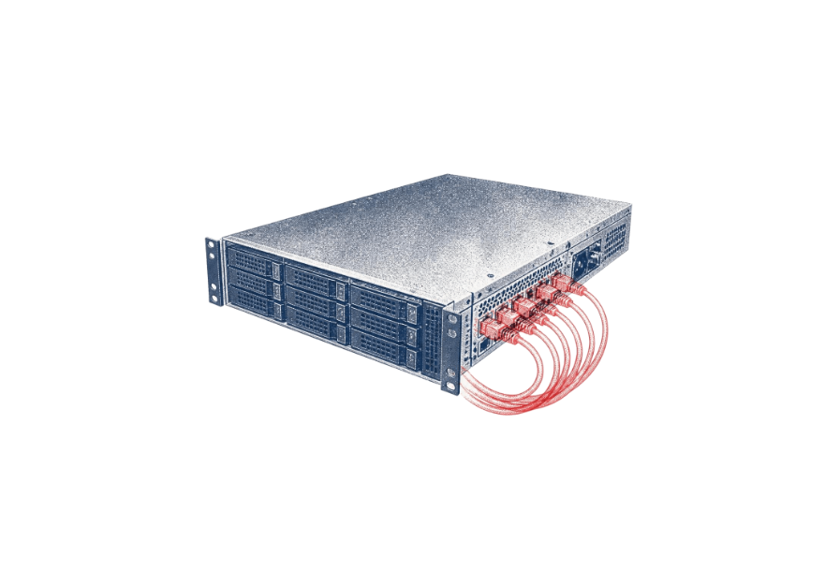
Create the VM
01
REFERENCE BUILD
Terraform clones the hardened template and registers the node’s scoped Vault role.
The reference setup for an Ansible control node
Authenticate on first boot
02
The server logs in to Vault using bootstrap credentials and retrieves its secrets.
Install the control environment
03
Chef installs pinned Ansible versions in a Python virtualenv, then creates the service account and directories.
Add Vault integration
04
Chef installs the Vault client and required Ansible collections and Python dependencies.
Generate inventory
The control node runs playbooks against other servers.
05
Terraform outputs inventory for the hosts the control node will manage. Keep credentials out of inventory.

Slide 9
WORKLOAD ACCESS
Connect Ansible to Vault, and let Vault sign its SSH access
Use Vault’s SSH secrets engine to sign short-lived SSH certificates. Managed hosts trust the signing CA’s public key; private keys stay on the control node, not on managed hosts.
Read playbook secrets with the community.hashi_vault collection’s hashi_vault lookup instead of storing values in files. Use ansible-vault only for bootstrap values, if at all.
Chef owns the control node
Ansible owns managed hosts
Operating system, hardening, service account, Python virtualenv and installed tooling.
Playbooks configure the remote servers. Keep their file ownership separate from Chef’s.
Constrain certificate principals and TTLs in the Vault role; protect the control node’s private key.

Slide 10
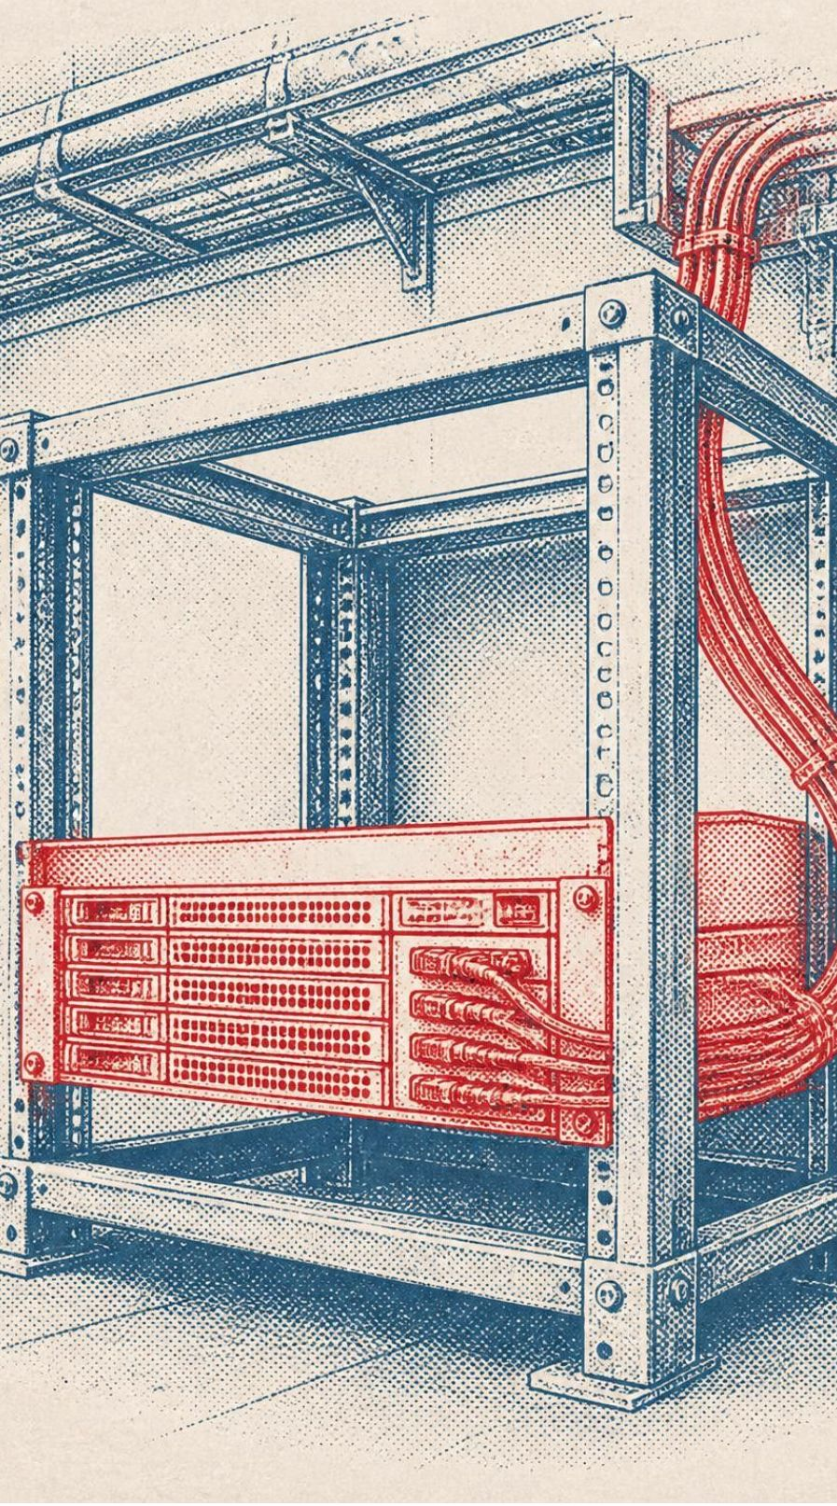
Pre-flight checklist and common mistakes
Verify the release boundary
Scoped Vault roles and audit logging enabled.
Encrypted, access-controlled state; no secrets in code.
Pinned tool versions and tested cookbooks.
Reject these failure patterns
One root token shared across tools.
Plaintext secrets in Terraform state or Chef attributes.
Chef and Ansible both managing the same files.
Lab first.
Repeatable before reusable.
Build one server end to end in a lab, then template it.

